Slide 1
JavaScript
CSE 3100 : Web Programming Laboratory
Subah Nawar
Lecturer,
Dept of CSE, KUET
Email: nawar@cse.kuet.ac.bd
Kazi Saeed Alam
Assistant Professor,
Dept of CSE, KUET
Email: saeed.alam@cse.kuet.ac.bd

Slide 2
What is it?
JavaScript is the world's most popular programming language.
JavaScript is the programming language of the Web.
JavaScript and Java are completely different languages, both in concept and design.
JavaScript was invented by Brendan Eich in 1995, and became an ECMA standard in 1997.

Slide 3
Why Study JavaScript?
JavaScript is one of the 3 languages all web developers must learn:
HTML to define the content of web pages.
CSS to specify the layout of web pages.
JavaScript to program the behaviour of web pages.

Slide 4
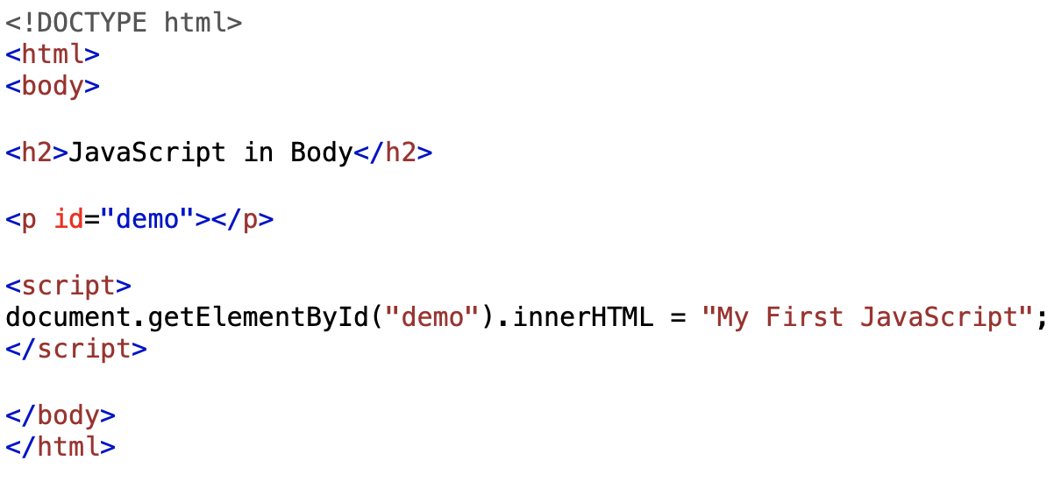
JavaScript Where To
The <script> Tag
In HTML, JavaScript code is inserted between <script> and </script> tags.

Slide 5
JavaScript Functions and Events
A JavaScript function is a block of JavaScript code, that can be executed when "called" for.
For example, a function can be called when an event occurs, like when the user clicks a button.

Slide 6
JavaScript in <head> or <body>
You can place any number of scripts in an HTML document.
Scripts can be placed in the <body>, or in the <head> section of an HTML page, or in both.

Slide 7
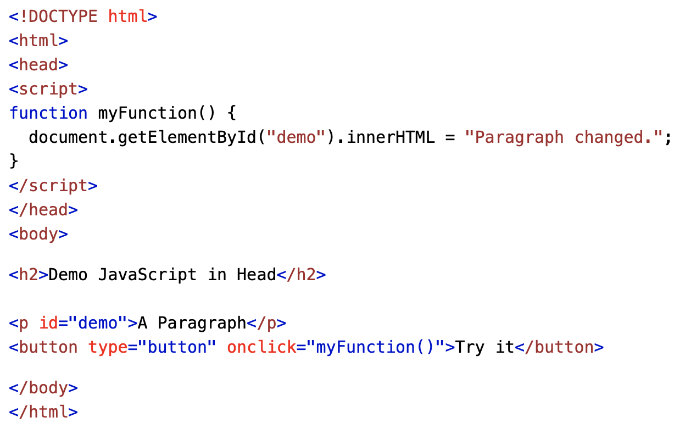
JavaScript in <head>
In this example, a JavaScript function is placed in the <head> section of an HTML page.
The function is invoked (called) when a button is clicked:

Slide 8
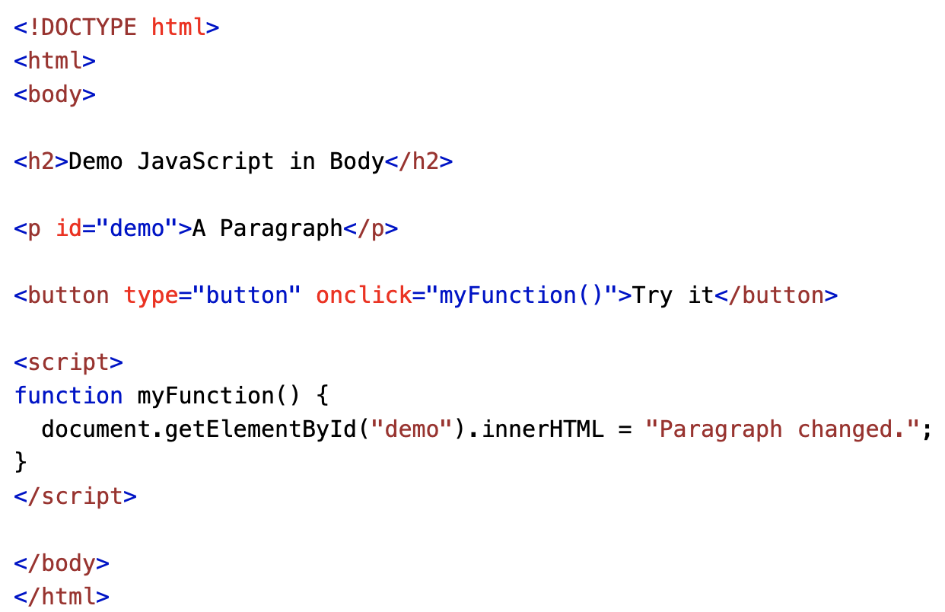
JavaScript in <body>
In this example, a JavaScript function is placed in the <body> section of an HTML page.
The function is invoked (called) when a button is clicked:

Slide 9
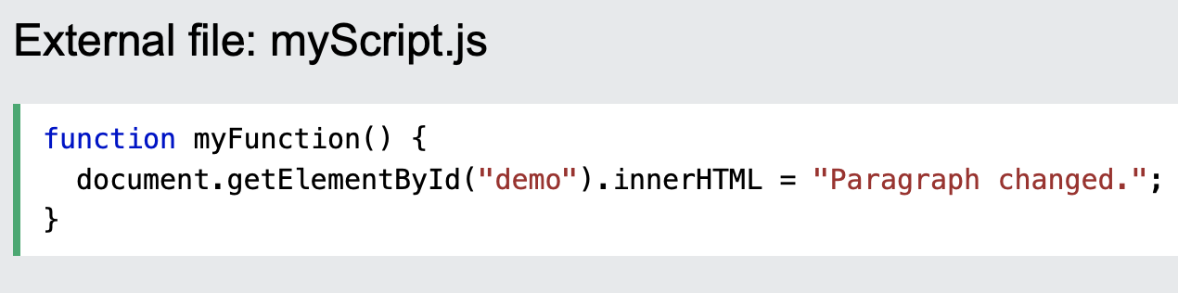
External JavaScript
Scripts can also be placed in external files:
External scripts are practical when the same code is used in many different web pages.
JavaScript files have the file extension .js.
To use an external script, put the name of the script file in the src (source) attribute of a <script> tag:

Slide 10
JavaScript Output
JavaScript can "display" data in different ways:
Writing into an HTML element, using innerHTML.
Writing into the HTML output using document.write().
Writing into an alert box, using window.alert().
Writing into the browser console, using console.log().

Slide 11
JavaScript Statements
JavaScript statements are composed of:
Values, Operators, Expressions, Keywords, and Comments.
This statement tells the browser to write "Hello Dolly." inside an HTML element with id="demo":
document.getElementById("demo").innerHTML = "Hello Dolly.";
The statements are executed, one by one, in the same order as they are written.

Slide 12
JavaScript Semicolons ;
Semicolons separate JavaScript statements.
Add a semicolon at the end of each executable statement:
let a, b, c; // Declare 3 variables a = 5; // Assign the value 5 to a b = 6; // Assign the value 6 to b c = a + b; // Assign the sum of a and b to c
When separated by semicolons, multiple statements on one line are allowed:
a = 5; b = 6; c = a + b;

Slide 13
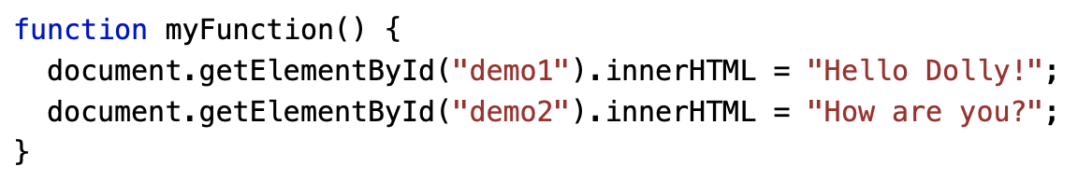
JavaScript Code Blocks
JavaScript statements can be grouped together in code blocks, inside curly brackets {...}.
The purpose of code blocks is to define statements to be executed together.
One place you will find statements grouped together in blocks, is in JavaScript functions:

Slide 14
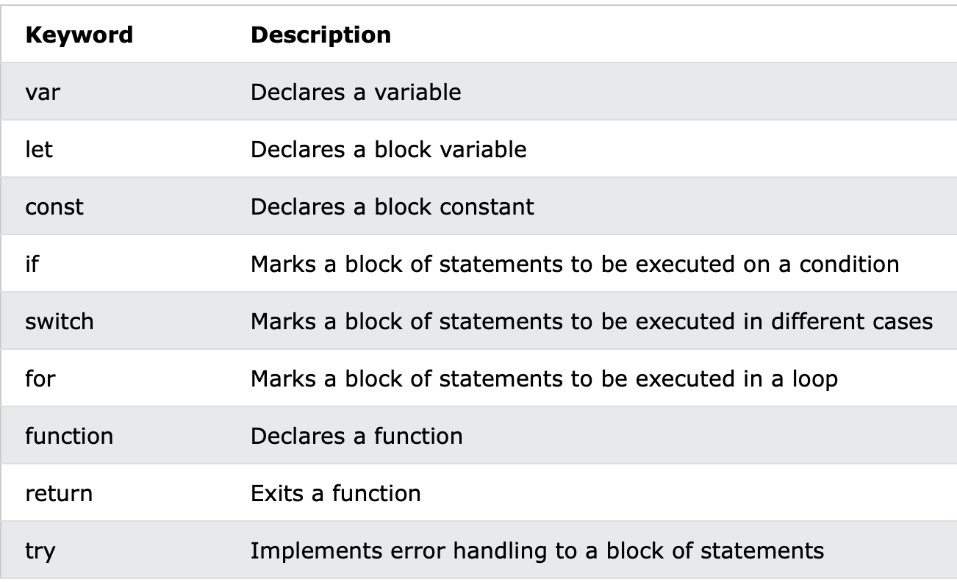
JavaScript Keywords
JavaScript statements often start with a keyword to identify the JavaScript action to be performed.
Notes:
In JavaScript, var, let, and const are used to declare variables, but they have some differences in terms of scope and reassignment.
var:
Variables declared with var are function-scoped, meaning they are only visible within the function where they are declared.
They are hoisted to the top of their scope, which means you can use them before they are declared in the code.
var allows for variable redeclaration within the same scope.
function example() {
var x = 1;
if (true) {
var x = 2; // This will overwrite the outer variable
console.log(x); // Outputs 2
}
console.log(x); // Outputs 2
}
let:
Variables declared with let are block-scoped, meaning they are only visible within the block (like inside an if statement or a loop) where they are defined.
let variables are not hoisted to the top of their scope.
Unlike var, let does not allow for variable redeclaration within the same scope.
function example() {
let x = 1;
if (true) {
let x = 2; // This is a different variable than the outer one
console.log(x); // Outputs 2
}
console.log(x); // Outputs 1
}
const:
Variables declared with const are also block-scoped.
They must be assigned a value when declared, and once assigned, their value cannot be changed (immutable).
Like let, const is not hoisted to the top of its scope.
function example() {
const x = 1;
if (true) {
const x = 2; // This is a different variable than the outer one
console.log(x); // Outputs 2
}
console.log(x); // Outputs 1
}
In general, it is recommended to use const by default and only use let when you know the value of the variable will change. Avoid using var in modern JavaScript, as it has some quirks that can lead to unexpected behavior.

Slide 15
JavaScript Syntax
How to create variables: var x; let y; How to use variables: x = 5; y = 6; let z = x + y;

Slide 16
JavaScript Values
The JavaScript syntax defines two types of values:
Fixed values
Variable values
Fixed values are called Literals.
Variable values are called Variables.

Slide 17
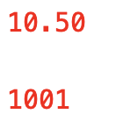
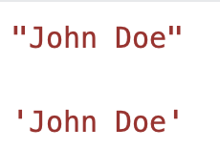
JavaScript Literals
The two most important syntax rules for fixed values are:
1. Numbers are written with or without decimals:
2. Strings are text, written within double or single quotes:

Slide 18
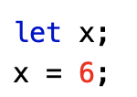
JavaScript Variables
In a programming language, variables are used to store data values.
JavaScript uses the keywords var, let and const to declare variables.
An equal sign is used to assign values to variables.
In this example, x is defined as a variable. Then, x is assigned (given) the value 6:

Slide 19
JavaScript Let and Var
Variables defined with let cannot be redeclared.
You cannot accidentally redeclare a variable.
With let you can not do this:
let x = "John Doe"; let x = 0;
With var you can:
var x = "John Doe"; var x = 0;
Notes:
In JavaScript, "redeclarable" and "reassignable" refer to different concepts related to variables.
Redeclarable:
A variable declared using var can be redeclared within the same scope without causing an error.
Example:
var x = 10;
var x = 20; // No error, x is redeclared
However, variables declared with let and const cannot be redeclared in the same scope:
let y = 30;
// let y = 40; // Error: Identifier 'y' has already been declared
Reassignable:
After declaring a variable, you can assign a new value to it regardless of the keyword used (var, let, or const), except for variables declared with const, which cannot be reassigned.
Example:
var z = 50;
z = 60; // Reassignment is allowed
let a = 70;
a = 80; // Reassignment is allowed
const b = 90;
// b = 100; // Error: Assignment to constant variable
In summary:
"Redeclarable" pertains to whether you can declare the same variable name again in the same scope.
"Reassignable" pertains to whether you can assign a new value to an existing variable.
Variables declared with var are both redeclarable and reassignable, variables declared with let are reassignable but not redeclarable, and variables declared with const are neither redeclarable nor reassignable within the same scope.

Slide 20
JavaScript Const
The const keyword was introduced in ES6 (2015).
Variables defined with const cannot be Redeclared.
Variables defined with const cannot be Reassigned.
Variables defined with const have Block Scope.
As a general rule, always declare a variable with const unless you know that the value will change.
const PI = 3.14159265359;

Slide 21

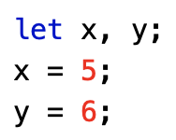
JavaScript Operators
JavaScript uses arithmetic operators ( + - * / ) to compute values:
JavaScript uses an assignment operator ( = ) to assign values to variables:

Slide 22
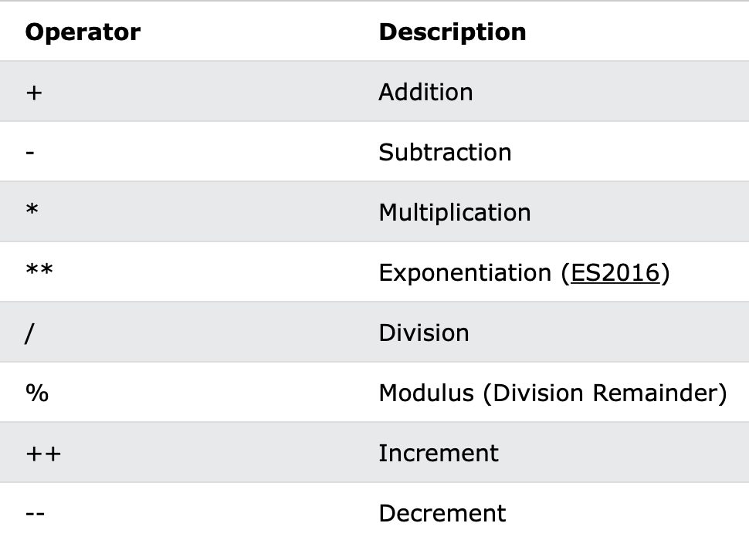
JavaScript Arithmetic Operators
Arithmetic operators are used to perform arithmetic on numbers:

Slide 23
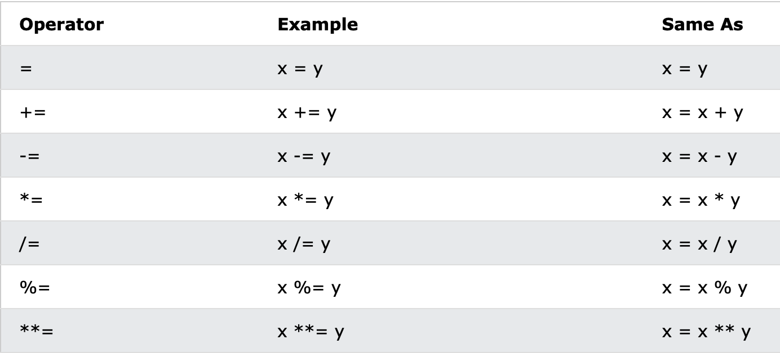
JavaScript Assignment Operators
Assignment operators assign values to JavaScript variables.

Slide 24
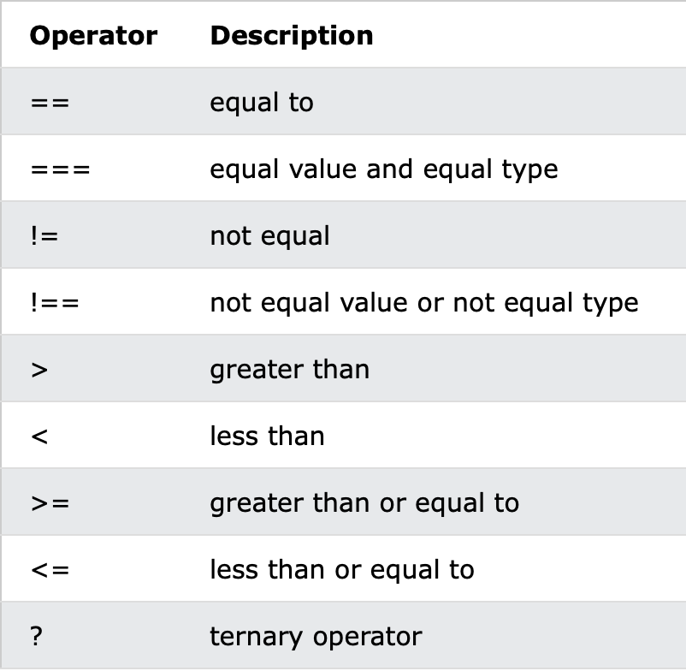
JavaScript Comparison Operators
Notes:
In JavaScript, == and === are two different comparison operators used to compare values.
== (Equality Operator):
This operator checks for equality after performing type coercion. It converts the operands to the same type before making the comparison.
For example, 5 == "5" would be true because the string "5" is coerced to the number 5 during the comparison.
=== (Strict Equality Operator):
This operator checks for equality without performing type coercion. It compares both the value and the type of the operands.
For example, 5 === "5" would be false because the value 5 is of type number, and the string "5" is of type string.
In general, it is recommended to use === (strict equality) to avoid unexpected results due to type coercion. Using === ensures that both the value and the type are the same for the comparison to be true.

Slide 25
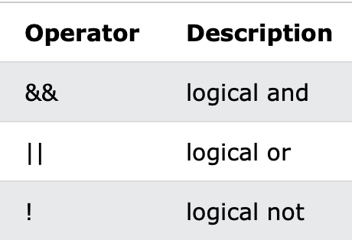
JavaScript Logical Operators

Slide 26
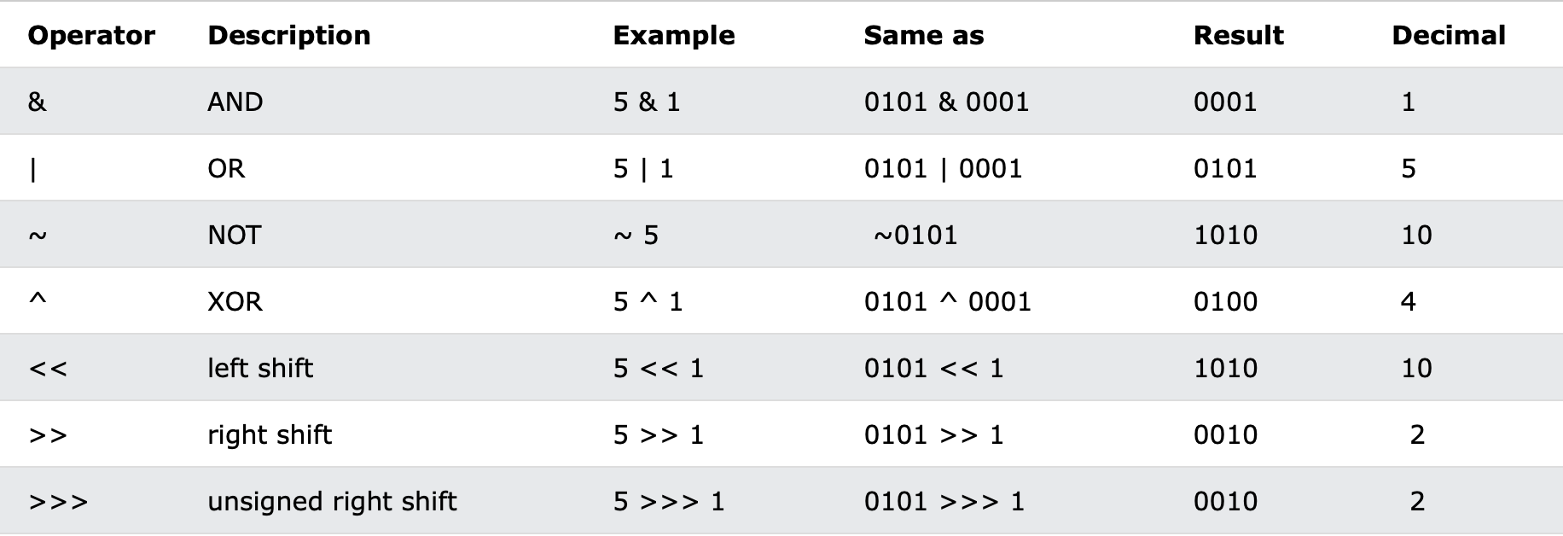
JavaScript Bitwise Operators
Notes:
In JavaScript, the >> and >>> are bitwise right shift operators.
>> (Signed Right Shift):
The >> operator shifts the bits of a number to the right. It preserves the sign bit, which means that if the number is positive, it pads the left side with zeros, and if the number is negative, it pads the left side with ones.
Example: x >> y shifts the bits of x to the right by y positions.
>>> (Unsigned Right Shift):
The >>> operator also shifts the bits to the right, but it always pads the left side with zeros, regardless of the sign of the number. It treats the number as if it were an unsigned integer.
Example: x >>> y shifts the bits of x to the right by y positions, and the left side is always padded with zeros.
Here's a quick example to illustrate the difference:
let x = -8;
console.log(x >> 2); // Output: -2 (Signed right shift)
console.log(x >>> 2); // Output: 1073741822 (Unsigned right shift)
In the example, x >> 2 performs a signed right shift, while x >>> 2 performs an unsigned right shift.

Slide 27
JavaScript Identifiers / Names
Identifiers are JavaScript names.
Identifiers are used to name variables and keywords, and functions.
The rules for legal names are the same in most programming languages.
A JavaScript name must begin with:
A letter (A-Z or a-z)
A dollar sign ($)
Or an underscore (_)
Subsequent characters may be letters, digits, underscores, or dollar signs.

Slide 28
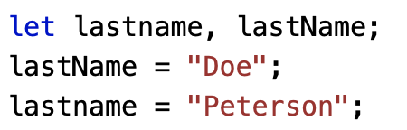
JavaScript is Case Sensitive
All JavaScript identifiers are case sensitive.
The variables lastName and lastname, are two different variables:
JavaScript does not interpret LET or Let as the keyword let.

Slide 29
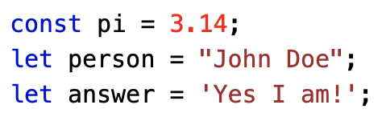
JavaScript Data Types
JavaScript variables can hold numbers like 100 and text values like "John Doe".
In programming, text values are called text strings.
JavaScript can handle many types of data, but for now, just think of numbers and strings.
Strings are written inside double or single quotes. Numbers are written without quotes.
If you put a number in quotes, it will be treated as a text string.

Slide 30
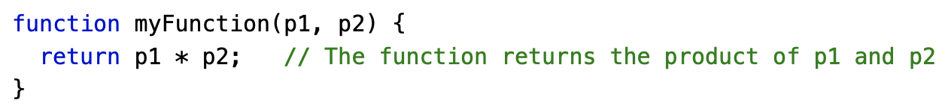
JavaScript Functions
A JavaScript function is a block of code designed to perform a particular task.
A JavaScript function is executed when "something" invokes it (calls it).

Slide 31
JavaScript Function Syntax
A JavaScript function is defined with the function keyword, followed by a name, followed by parentheses ().
Function names can contain letters, digits, underscores, and dollar signs (same rules as variables).
The parentheses may include parameter names separated by commas: (parameter1, parameter2, ...)
The code to be executed, by the function, is placed inside curly brackets: {}

Slide 32
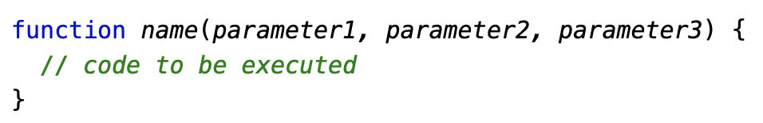
JavaScript Function Syntax
Function parameters are listed inside the parentheses () in the function definition.
Function arguments are the values received by the function when it is invoked.
Inside the function, the arguments (the parameters) behave as local variables.

Slide 33
Function Invocation
The code inside the function will execute when "something" invokes (calls) the function:
When an event occurs (when a user clicks a button)
When it is invoked (called) from JavaScript code
Automatically (self invoked)

Slide 34
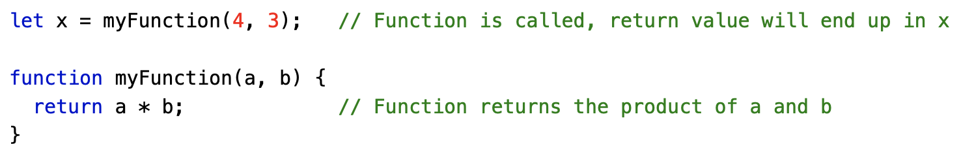
Function Return
When JavaScript reaches a return statement, the function will stop executing.
If the function was invoked from a statement, JavaScript will "return" to execute the code after the invoking statement.
Functions often compute a return value. The return value is "returned" back to the "caller":

Slide 35
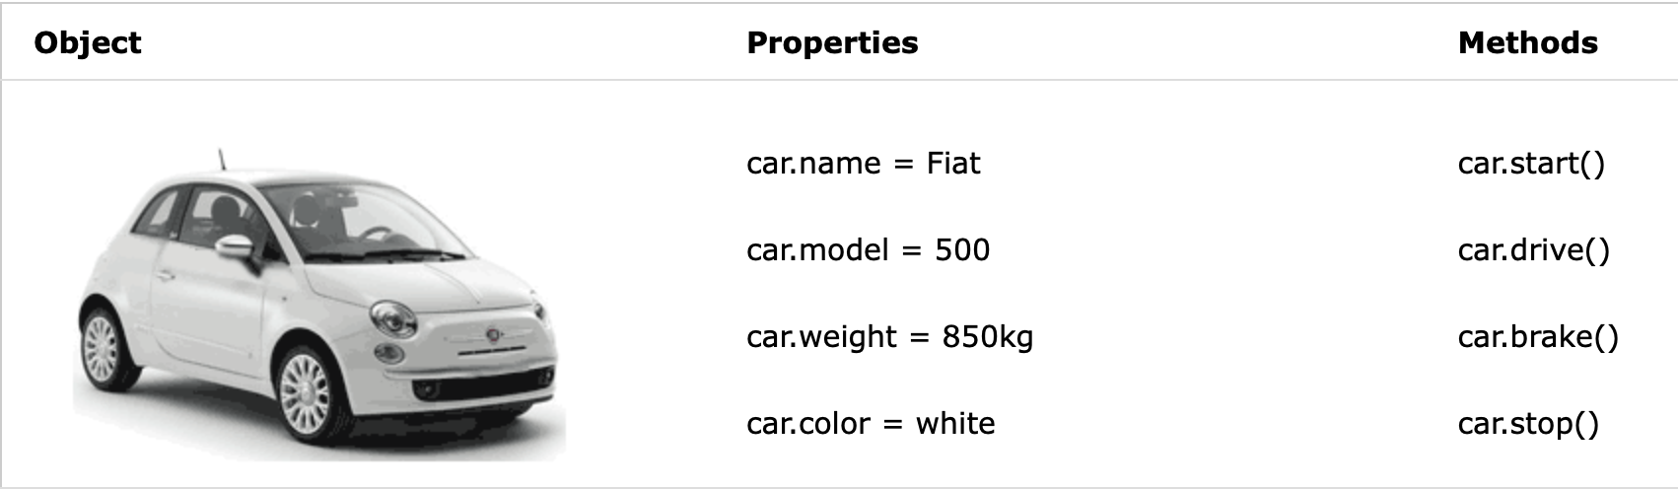
Real Life Objects, Properties, and Methods
In real life, a car is an object.
A car has properties like weight and color, and methods like start and stop:
All cars have the same properties, but the property values differ from car to car.
All cars have the same methods, but the methods are performed at different times.

Slide 36

JavaScript Objects
You have already learned that JavaScript variables are containers for data values.
This code assigns a simple value (Fiat) to a variable named car:
Objects are variables too. But objects can contain many values.
This code assigns many values (Fiat, 500, white) to a variable named car:
The values are written as name:value pairs (name and value separated by a colon).

Slide 37
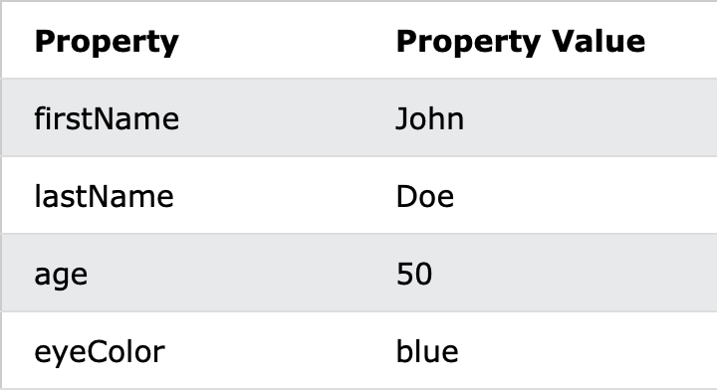


Object Properties
The name:values pairs in JavaScript objects are called properties:
You can access object properties in two ways:
or

Slide 38
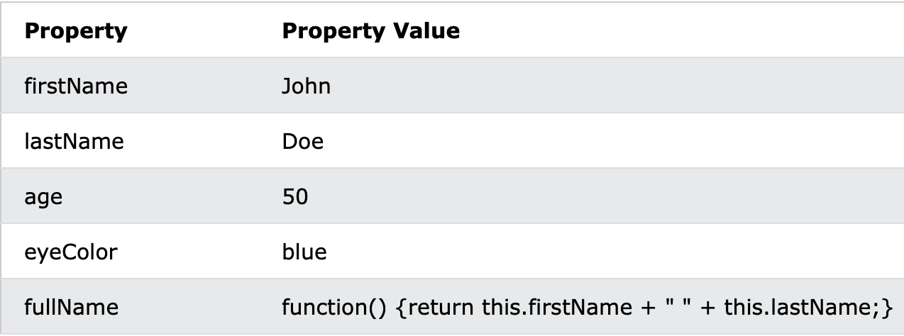
Object Methods
Objects can also have methods.
Methods are actions that can be performed on objects.
Methods are stored in properties as function definitions.
A method is a function stored as a property.

Slide 39
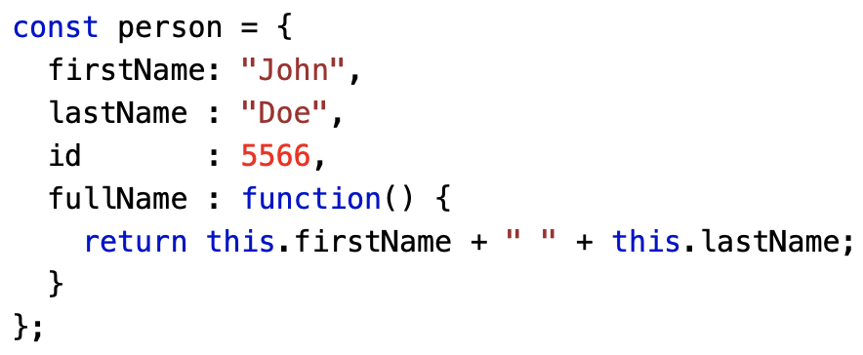
Object Method Example
In the example above, this refers to the person object.
I.E. this.firstName means the firstName property of this.
I.E. this.firstName means the firstName property of person.

Slide 40
The this Keyword
In a function definition, this refers to the "owner" of the function.
In the example above, this is the person object that "owns" the fullName function.
In other words, this.firstName means the firstName property of this object.

Slide 41



Accessing Object Methods
You access an object method with the following syntax:
If you access a method without the () parentheses, it will return the function definition:

Slide 42
JavaScript Events
HTML events are "things" that happen to HTML elements.
When JavaScript is used in HTML pages, JavaScript can "react" on these events.
An HTML event can be something the browser does, or something a user does.
Here are some examples of HTML events:
An HTML web page has finished loading
An HTML input field was changed
An HTML button was clicked
Often, when events happen, you may want to do something.
JavaScript lets you execute code when events are detected.

Slide 43
Example
In the following example, an onclick attribute (with code), is added to a <button> element:
In the example above, the JavaScript code changes the content of the element with id="demo".
In the next example, the code changes the content of its own element (using this.innerHTML):

Slide 44
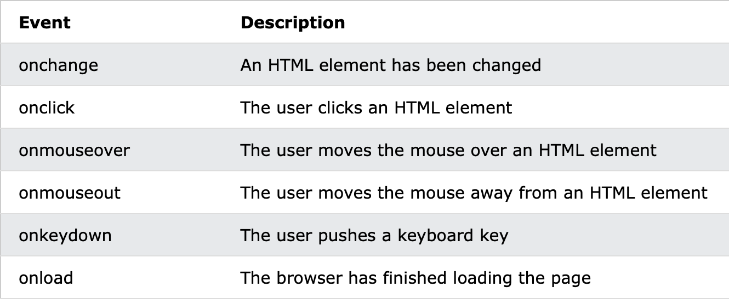
Common HTML Events
Here is a list of some common HTML events:

Slide 45
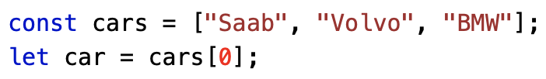
JavaScript Arrays
An array is a special variable, which can hold more than one value:
Using an array literal is the easiest way to create a JavaScript Array.
Syntax:
You access an array element by referring to the index number:

Slide 46
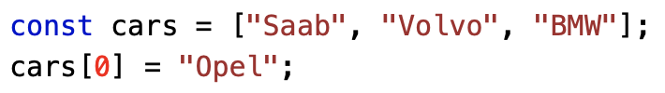

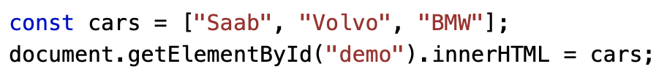
Changing an Array Element
This statement changes the value of the first element in cars:
With JavaScript, the full array can be accessed by referring to the array name:

Slide 47

Arrays are Objects
Arrays are a special type of objects. The typeof operator in JavaScript returns "object" for arrays.
But, JavaScript arrays are best described as arrays.
Arrays use numbers to access its "elements". In this example, person[0] returns John:

Slide 48
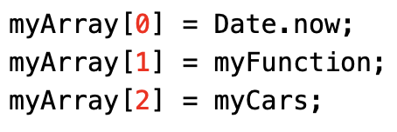
Array Elements Can Be Objects
JavaScript variables can be objects. Arrays are special kinds of objects.
Because of this, you can have variables of different types in the same Array.
You can have objects in an Array. You can have functions in an Array. You can have arrays in an Array:

Slide 49
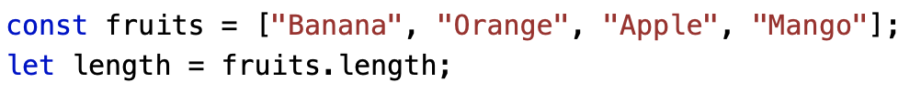
The length Property
The length property of an array returns the length of an array (the number of array elements).
The length property is always one more than the highest array index.

Slide 50
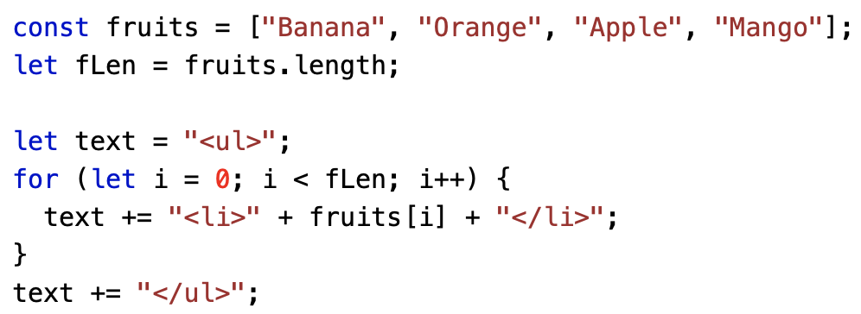
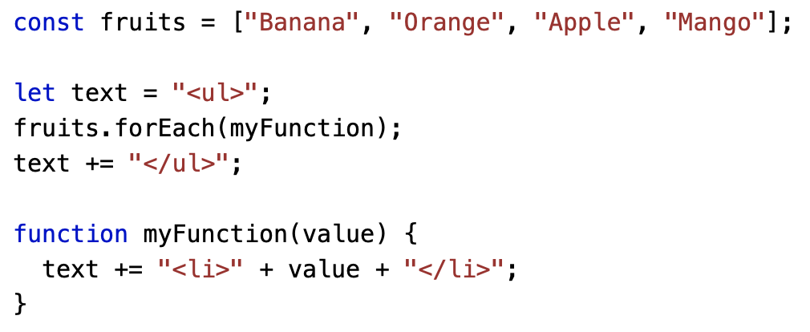
Looping Array Elements
One way to loop through an array, is using a for loop:
You can also use the Array.forEach() function:

Slide 51
Adding Array Elements
The easiest way to add a new element to an array is using the push() method:
New element can also be added to an array using the length property:

Slide 52
JavaScript if, else, and else if
Very often when you write code, you want to perform different actions for different decisions.
You can use conditional statements in your code to do this.
In JavaScript we have the following conditional statements:
Use if to specify a block of code to be executed, if a specified condition is true
Use else to specify a block of code to be executed, if the same condition is false
Use else if to specify a new condition to test, if the first condition is false
Use switch to specify many alternative blocks of code to be executed

Slide 53
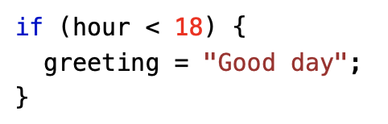
The if Statement
Use the if statement to specify a block of JavaScript code to be executed if a condition is true.
if (condition) { // block of code to be executed if the condition is true }
Make a "Good day" greeting if the hour is less than 18:00:

Slide 54
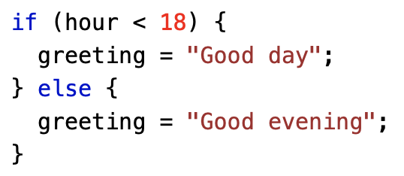
The else Statement
Use the else statement to specify a block of code to be executed if the condition is false.
if (condition) { // block of code to be executed if the condition is true } else { // block of code to be executed if the condition is false }
If the hour is less than 18, create a "Good day" greeting, otherwise "Good evening":

Slide 55
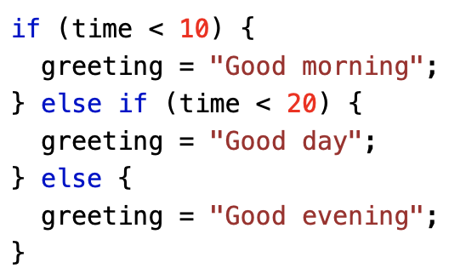
The else if Statement
Use the else if statement to specify a new condition if the first condition is false.
if (condition1) { // block of code to be executed if condition1 is true } else if (condition2) { // block of code to be executed if the condition1 is false and condition2 is true } else { // block of code to be executed if the condition1 is false and condition2 is false }
If time is less than 10:00, create a "Good morning" greeting, if not, but time is less than 20:00, create a "Good day" greeting, otherwise a "Good evening":

Slide 56
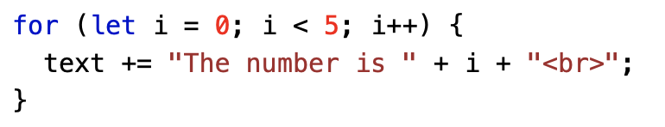
The For Loop
The for statement creates a loop with 3 optional expressions:
for (expression 1; expression 2; expression 3) { // code block to be executed }
Expression 1 is executed (one time) before the execution of the code block.
Expression 2 defines the condition for executing the code block.
Expression 3 is executed (every time) after the code block has been executed.

Slide 57
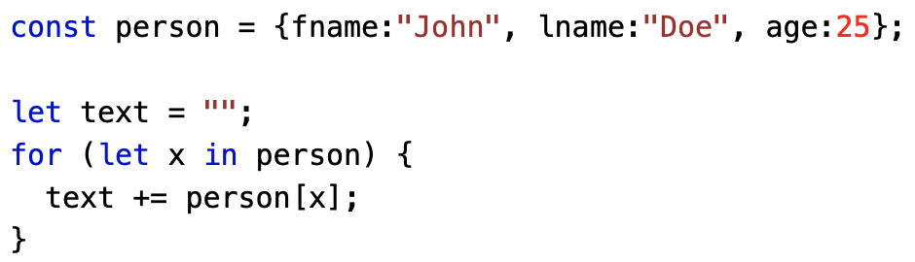
The For In Loop
The JavaScript for in statement loops through the properties of an Object:
for (key in object) { // code block to be executed }

Slide 58
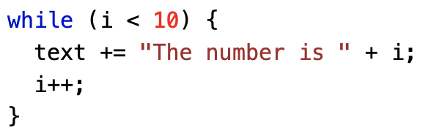
The While Loop
The while loop loops through a block of code as long as a specified condition is true.
while (condition) { // code block to be executed }
In the following example, the code in the loop will run, over and over again, as long as a variable (i) is less than 10:

Slide 59
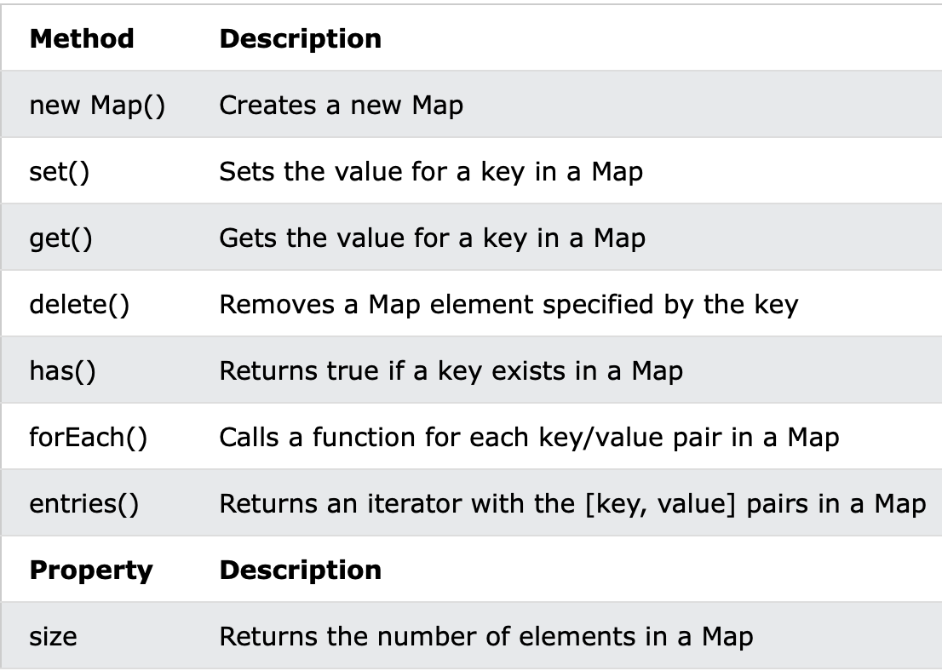
JavaScript Maps
A Map holds key-value pairs where the keys can be any datatype.
A Map remembers the original insertion order of the keys.

Slide 60
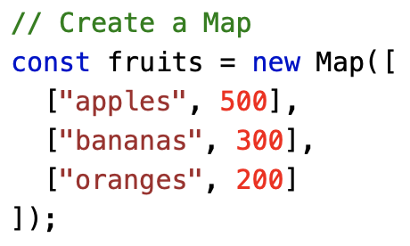
The new Map() Method
You can create a Map by passing an Array to the new Map() constructor:

Slide 61
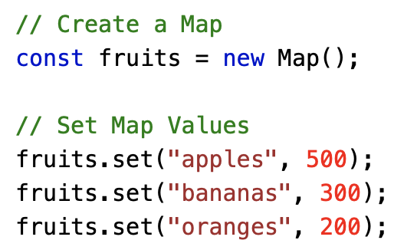

The set() Method
You can add elements to a Map with the set() method:
The set() method can also be used to change existing Map values:

Slide 62
The get() Method
The get() method gets the value of a key in a Map:

Slide 63
JavaScript Classes
ECMAScript 2015, also known as ES6, introduced JavaScript Classes.
JavaScript Classes are templates for JavaScript Objects.
Use the keyword class to create a class.
Always add a method named constructor():
Syntax :
class ClassName { constructor() { ... } }

Slide 64
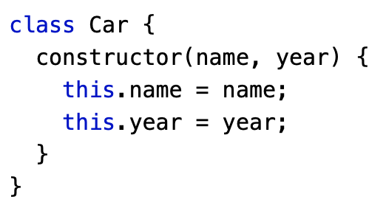
JavaScript Class Example
The example below creates a class named "Car".
The class has two initial properties: "name" and "year".

Slide 65
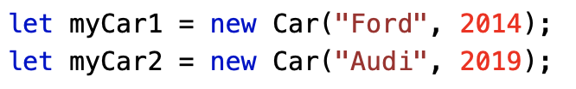
Using a Class
When you have a class, you can use the class to create objects.
The example above uses the Car class to create two Car objects.
The constructor method is called automatically when a new object is created.

Slide 66
The Constructor Method
The constructor method is a special method:
It has to have the exact name "constructor"
It is executed automatically when a new object is created
It is used to initialize object properties
If you do not define a constructor method, JavaScript will add an empty constructor method.

Slide 67
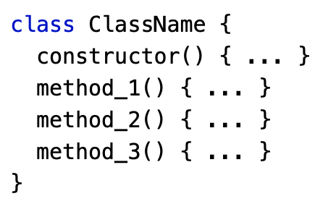
Class Methods
Class methods are created with the same syntax as object methods.
Use the keyword class to create a class.
Always add a constructor() method.
Then add any number of methods.
Notes:
In JavaScript, class properties and static properties are features that are used in object-oriented programming to define and manage data within classes.
Class Properties: These are properties that are defined within a class and are accessible through instances of the class. Each instance of the class can have its own unique values for these properties.
Static Properties: These are properties that are associated with the class itself rather than with any particular instance. They are accessed directly through the class and are shared among all instances of the class.
Here's an example of how they are used in JavaScript:
class MyClass {
// Class property
instanceProperty = "I am a class property";
// Static property
static staticProperty = "I am a static property";
}
const instance1 = new MyClass();
const instance2 = new MyClass();
console.log(instance1.instanceProperty); // Output: "I am a class property"
console.log(instance2.instanceProperty); // Output: "I am a class property"
console.log(MyClass.staticProperty); // Output: "I am a static property"
In this example, instanceProperty is a class property, and staticProperty is a static property. Each instance of MyClass has its own instanceProperty value, while staticProperty is shared among all instances of MyClass.

Slide 68
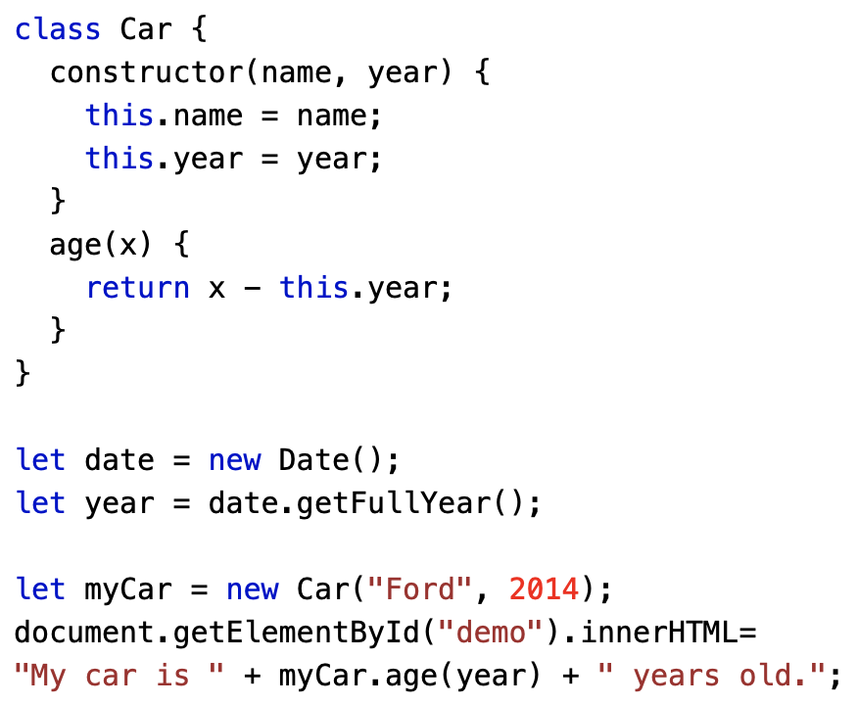
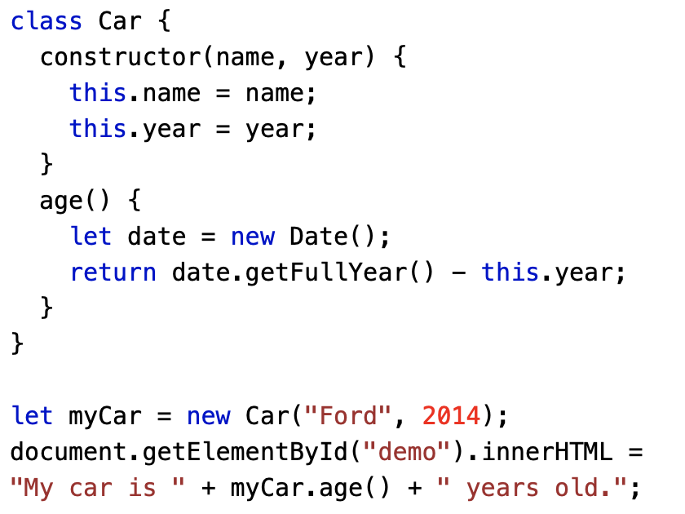
Example of Class Methods
Create a Class method named "age", that returns the Car age:
You can send parameters to Class methods:

Slide 69
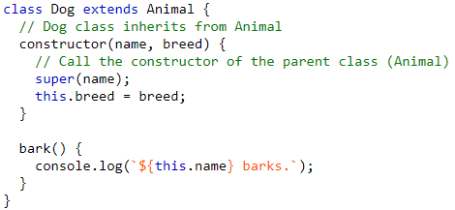
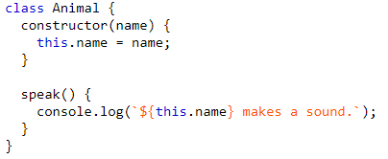
Class Inheritance
This is achieved through the use of the extends keyword.
Inheritance is a way to create a new class that is a modified version of an existing class.
This is achieved through the use of the extends keyword.

Slide 70

Example of Class Inheritance
This is achieved through the use of the extends keyword.
In this example, the Dog class extends the Animal class, inheriting its properties and methods.
The super keyword is used to call the constructor of the parent class within the constructor of the child class.
This way, instances of the Dog class have access to both the speak method from the Animal class and the bark method defined in the Dog class.
Notes:
JavaScript does not support multiple inheritance in the traditional sense, where a class can directly inherit from multiple classes. However, JavaScript supports a form of multiple inheritance through a mechanism called "mixins" and “prototype chaining”.
Mixins: Mixins are a way to combine the properties and methods of multiple objects into a new object. You can create separate objects with specific functionalities and then mix them together. This is a form of achieving multiple inheritance.
// Example of using mixins
const mixin1 = {
method1() {
console.log('Method 1');
}
};
const mixin2 = {
method2() {
console.log('Method 2');
}
};
class MyClass {}
Object.assign(MyClass.prototype, mixin1, mixin2);
const obj = new MyClass();
obj.method1(); // Output: Method 1
obj.method2(); // Output: Method 2
Prototype Chaining: JavaScript uses prototype-based inheritance. Objects inherit properties and methods from their prototype. While it's not traditional class-based multiple inheritance, you can achieve similar effects by linking prototypes.
function Parent1() {
this.method1 = function() {
console.log('Method 1');
};
}
function Parent2() {
this.method2 = function() {
console.log('Method 2');
};
}
function Child() {
// Prototype chaining
Parent1.call(this);
Parent2.call(this);
}
const childObj = new Child();
childObj.method1(); // Output: Method 1
childObj.method2(); // Output: Method 2
These approaches provide a way to achieve some level of multiple inheritance in JavaScript, but they are different from classical multiple inheritance found in languages like C++ or Java. It's important to note that using composition and other design patterns is often recommended in JavaScript to achieve code reuse and maintainability.

Slide 71
Class Inheritance
This is achieved through the use of the extends keyword.
Inheritance is a way to create a new class that is a modified version of an existing class.
This is achieved through the use of the extends keyword.

Slide 72
HTML DOM
When a web page is loaded, the browser creates a Document Object Model of the page.
Document Object Model (DOM) is a platform and language-neutral interface that allows programs and scripts to dynamically access and update the content, structure, and style of a document.

Slide 73
DOM Manipulation
Selecting with id
document.getElementById(“Id”)
Selecting with class
document.getElementsByClassName(“ClassName”)
Selecting with tag
document.getElementsByTagName(“p”)

Slide 74
DOM Manipulation
Query Selector
document.querySelector(“#myId / .myClass / tag”)
//returns first element
document.querySelectorAll(“#myId / .myClass / tag”)
//returns a NodeList

Slide 75
DOM Manipulation
Properties
tagName : returns tag for element nodes
innerText : returns the text content of the element and all its children
innerHTML : returns the plain text or HTML contents in the element
textContent : returns textual content even for hidden elements

Slide 76
DOM Manipulation
Attributes:
getAttribute( attr ) //to get the attribute value
setAttribute(attr) //to set the attribute value

Slide 77
Events
Mouse events (click etc.)
Keyboard events (keyup,keydown)
Form events (submit etc.)

Slide 78
Reference
https://www.w3schools.com/js/
https://www.educative.io/answers/what-is-static-property-and-method-in-javascript
https://www.geeksforgeeks.org/encapsulation-in-javascript/
https://developer.mozilla.org/en-US/docs/Web/Events
Notes:
Self-study: Promise, async/await

Slide 79
Thank You!

